Slide 1
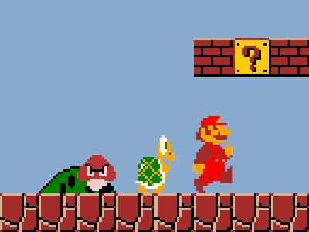
DATA COMPRESSION
Digital Technology | AS1 |Mr Butler

Slide 2
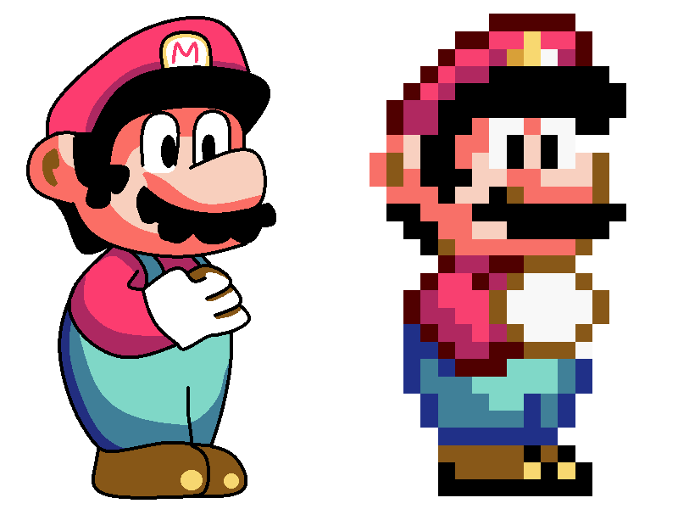


What Is Data Compression?
Data compression is the process associated with reducing the memory or storage required by large files.
This is often important when it comes to data transmission and storage on backing storage devices or transferring data from one place to another.
Data compression uses a series of algorithms to reduce the amount of real space taken up by data on a storage medium.
DATA

Slide 3

+
-
By reducing the size of the file, the amount of storage required is reduced
As compression reduces the size of the file, transmission and download/upload times are also reduced
Some compression techniques reduce the quality of images as there may be some reduction in details
Other compression techniques require specialist software (such as winzip) to uncompress the file to view the file again.

Slide 4
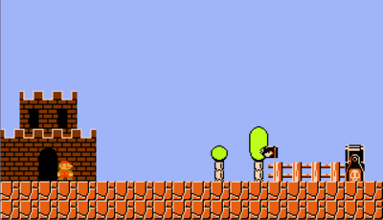
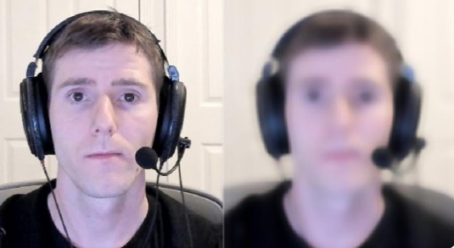
https://www.youtube.com/watch?v=guo8if4Yxhw&feature=youtu.be&list=PL1HhLdihIWo-EnZkn9v1NzaNXOMbxQEUy

Slide 5
Compression is used to reduce file sizes and change various attributes of an image file. These attributes include:
  file type – different file formats store the data differently than one another
  Resolution – the amount of pixels
  Dimensions – the height and width of the image
  bit depth - Number of bits used in representing the smallest unit of information (such as a byte or pixel) in an audio/video or graphic data file

Slide 6

Types of Compression
Compression can be lossy or lossless. Lossless compression means that as the file size is compressed, the picture quality remains the same - it does not get worse.
Also, the file can be decompressed to its original quality.
Lossy compression permanently removes data

Slide 7
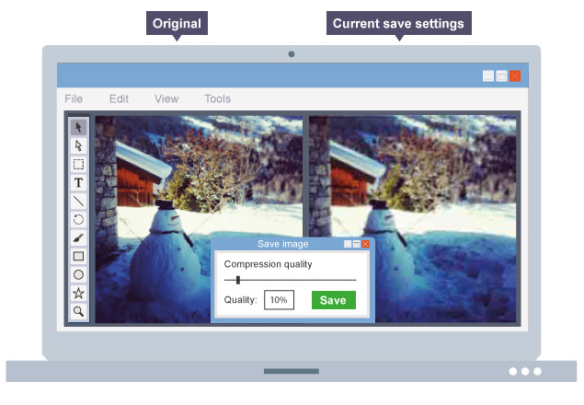


Lossy Compression

Slide 8

Compress or Uncompressed file type?
Lossy Compression | Lossless Compression
JPEG
PNG
GIF
SVG

Slide 9
_____________________ AABBBBBBAAABBABABBBB
At present, this text is 20 characters long
CHALLENGE
Can you come up with a way of shortening this piece of text?

Slide 10
_____________________ AABBBBBBAAABBABABBBB
_____________________ 2A6B3A2B1A1B1A4B
How About:
Now we only have 16 Characters Stored – but still have the same information.

Slide 11
Activity
Compress the following texts
A A A A B B B B B B C C C B B B A C C C
C C C C A C A C A B C C C B B B A B A B
D C B A D C B A A B C D A A B B C C D D
Expand the following
2B 3A 1B 1A 1C
3A 1B 1C 1B 1C 1B 2A 3B
3(AB) 4C A B C 2(BC)

Slide 12

How Zipping Works
Firstly, what is zipping?
  Zipping is the process of compressing data files.
  Uses an algorithm known as LZW algorithm to reduce the memory or storage required by large files
The LZW algorithm looks for repeating patterns in the data being compressed and will then replace these repeating patterns with a single character.

Slide 13

Evaluating Data File Formats
All files written to a storage medium must have a unique file name.
The first part of the file name will be determined by the user and help them identify the file at a later date.
  The second part (the file extension) will help identify that file as being a certain file type

Slide 14
The txt file Extension
Files which are presented as lines of electronic text
Files are readable to the human eye but contain no formatting information and may often be used to store information which requires further processing by another application
Some operating systems add an EOF character after the last line in the text file to denote the end of the txt file

Slide 15
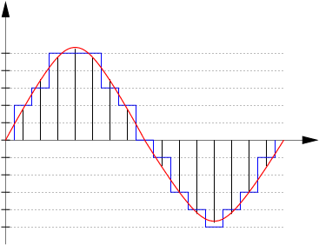
The WAV Extension
Used for professional recording + editing
Files use a process known as sampling to store a digital representation of a recorded analogue sound signal.
  During this process the amplitude (loudness) of the waveform being received are analysed very quickly and recorded
  It is the angular waveform that is played back to the user
Generally a WAV file is uncompressed, although can sometimes also be used to store compressed formats.
  A header in the file will indicate if the file is compressed or uncompressed format.

Slide 16
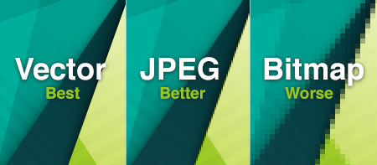
Activity: The Difference between JPEG and BMP
What are these file formats?
How do they work?
When should we use one or the other?
Are the compressed or uncompressed file formats?

Slide 17
https://1stwebdesigner.com/image-file-types/
Review the information from the above website.
Your task is to note and evaluate the different file formats explained.
Then complete Questions 1-5 of Fact File.

Slide 18
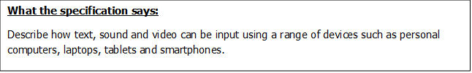
Inputting Text, Sound and Images Using Digital Devices

Slide 19
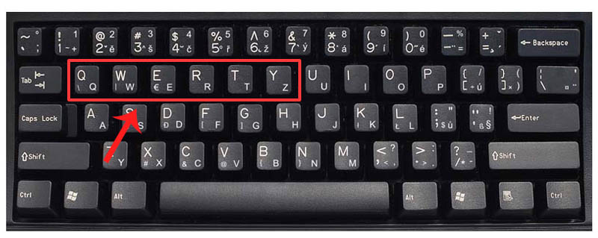
Inputting Text using a Keyboard on a PC or Laptop
Text input – text may be input to digital devices using a variety of methods; the most common being via a keyboard. The QWERTY keyboard is the most common keyboard format available on digital devices; it will incorporate letters, digits and a range of special characters. Some devices may however have a separate numeric keypad.

Slide 20
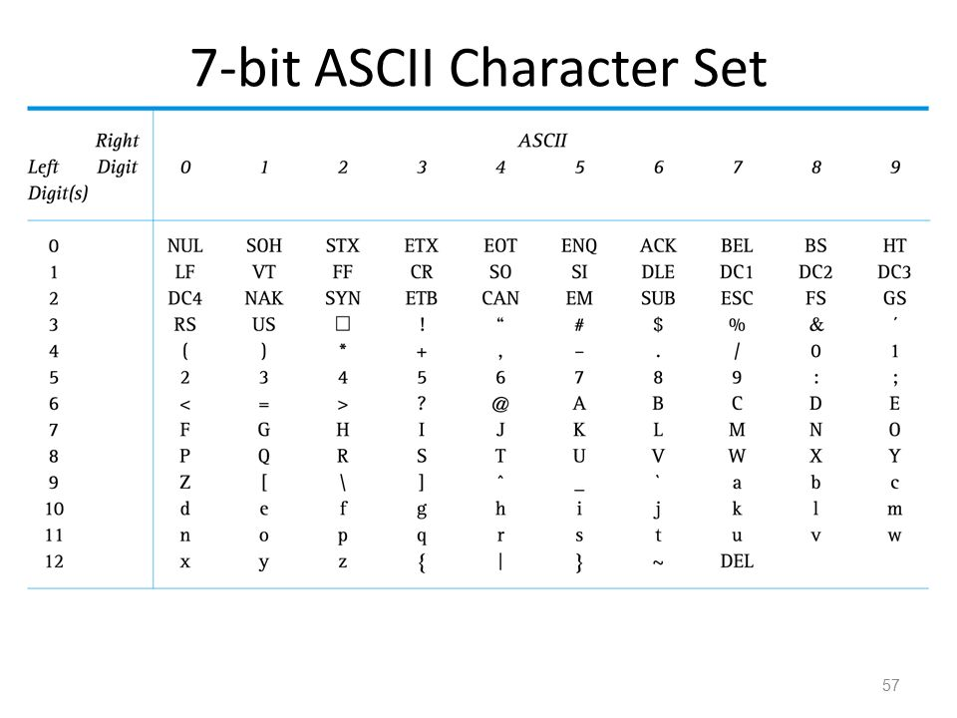
The set of characters represented on a digital device at any one time is known as the character set of that device. ASCII (American Standard Code for Information Interchange) is a common character set on digital devices.
The ASCII code uses 7 bits which gives 32 control codes and 96 displayable characters or symbols. The eighth bit can be used for error checking.

Slide 21
The depression / selection of a key on any device will generate a digital signal representing the character code.
When a symbol representing a particular character is to be printed or displayed on the screen of a particular device the character code is converted into the appropriate symbol

Slide 22
Q. Convert 072 069 076 076 079 032 087 079 082 076 068 into ASCII Text

Slide 23
Features of a Keyboard (How it Works/ how data is input)
Underneath the keys there is a key matrix / electronic switch (grid of circuits)
When the user presses a key/key combination
Each key/key combination has a unique binary code
…which is stored in a buffer
When the return key is pressed
…the contents of the buffer are sent to the computer

Slide 24
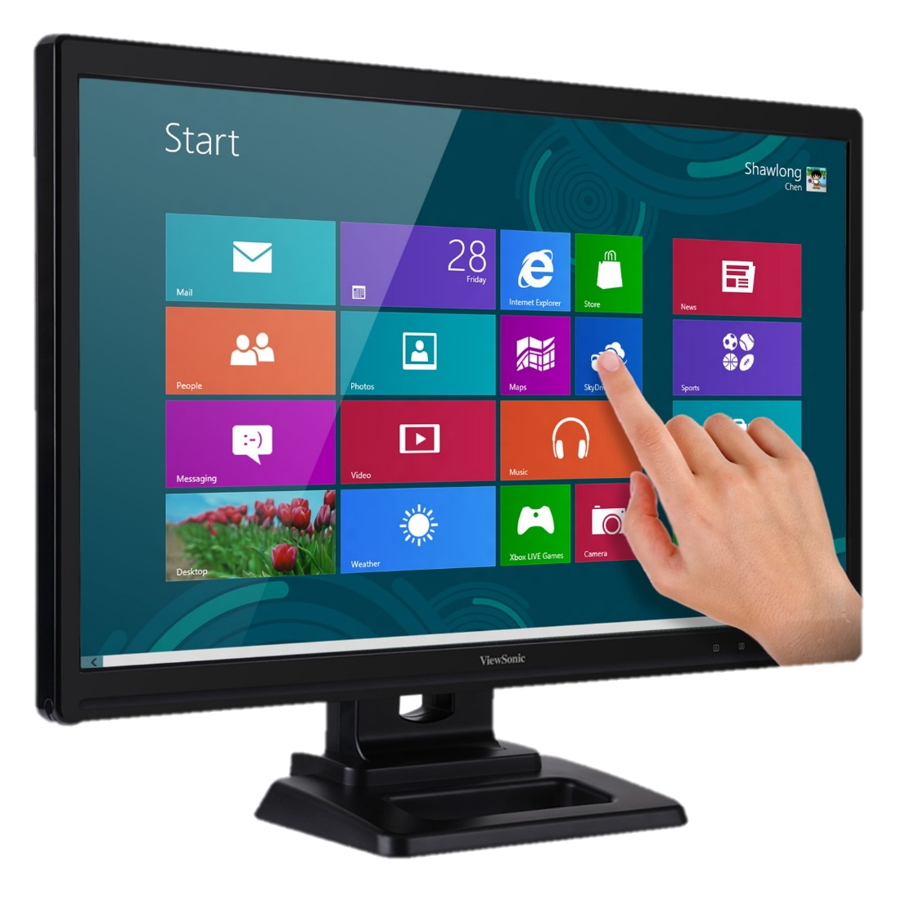
Inputting Text using a Touch Screen on a PC, Tablet or Smart Phone
When you touch the surface of such a screen, it detects exactly where you touched it. For example if you touched the screen 5cm down from the top and 3cm from the left, this data is used as input for the software currently running on its computer.
Usually there is some kind of graphics on display so that it appears you are 'touching' buttons and menu selections.
Notes:
https://www.youtube.com/watch?v=IdWXT391FJE

Slide 25
Types Of Touchscreen – Are there different types?
Capacitive (pressure-sensitive membrane)
  These are made by adding conductive coatings to a clear glass sensor.
  This consists of a grid of tiny, transparent electrodes.
  When the screen is not in use, electrodes spread out the voltage evenly.
  The touch screen displays a keyboard
  When the screen is touched with a finger or a stylus the disturbance is recognized by a change in the electrostatic properties at that point.
  The X Y co-ordinates are then sent from the controller to the PC and enables the typed character to be determined.
  Capacitive screens can be sealed, making them resistant to water, dust and grease. They are then very suitable for almost any environment.

Slide 26
Resistive (pressure-sensitive membrane)
  A hard coated polyester top sheet is laid on top of a conductive clear glass sensor.
  When the surface is pressed and makes contact with the sensor, voltage flows to each of the 4 corners in proportion to the distance from the edge.
  The controller then works out using the X Y co-ordinates the position of the touch.

Slide 27
Describe how a typical touch screen can be used to input text into a smart phone [4]
A capacitive touch screen is used [1]
This consists of a grid of tiny, transparent electrodes [1]
The touch screen displays a keyboard [1]
When the screen is touched with a finger or stylus, there is a change in the electrostatic properties at that point [1]
This enables the typed character to be determined

Slide 28
Inputting Sound using a Microphone on a PC, Laptop, Tablet or Smart Phone
Sound input – most digital devices are now supplied with simple microphones for recording sound.
Since sound is produced by the vibration of air it can be said to be analogue in format (i.e. it is a continually varying signal).
The electrical output from a microphone also consists of a continually varying signal in the form of voltage.

Slide 29
Devices such as personal computers, laptops, tablets or smartphones all store data in digital format so conversion of the analogue signal and the digital data is needed.
This is achieved through the process of sound sampling where special hardware measures the level of the sound many times and then records this as a numerical value.

Slide 30
During the sampling process the amplitude of the waveform being received are analysed very quickly and recorded.
Sound is converted into binary for computers to be able to process it. To do this sound is captured (usually by a microphone) and then converted into a digital signal.
An analogue to digital converter will sample a sound wave at regular time intervals. The samples can then be converted to binary.
They will then be recorded to the nearest whole number.
Sampling does not take into account what the sound wave is doing in between each time sample. This means that the sound loses quality as data has been lost between the time samples.
To increase the quality and have sound quality closer to the original is to have more time samples that are closer together. Higher Quality=More Time Samples

Slide 31
Describe how voice can be input and recorded on a PC [4]
A microphone
…attached to a soundcard is used to capture speech
The signal is converted from analogue to digital
An analogue to digital converter will sample the amplitude of the sound at regular time intervals
The samples will then be converted to binary / They will then be recorded to the nearest whole number in binary format.

Slide 32
Speech Recognition Systems
There are software programs that allow the user to directly speak to computing systems.
These systems may be:
  Simple – e.g. Voice activated commands or
  Sophisticated
    e.g. Word Processing systems that translate the user’s speech into text based data, but work essentially in the same way.

Slide 33
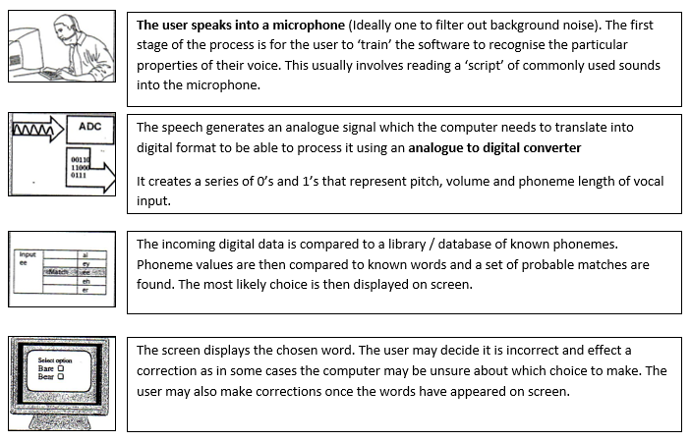
The Process

Slide 34
Inputting Video using a Camera on a PC, Laptop, Tablet or Smart Phone
Video input – it is common place now for digital devices to have a camera incorporated for the recording of digital still and digital video images.
Digital video cameras have two main components; the camera, which is the image capturing component, and the recorder which is the component of the video camera that stores the captured video images.
The image is recorded using the digital camera. The captured image is then transmitted into computer pixels which is then stored in whatever media storage is available to the digital video camera.

Slide 35

Fact File Questions
An image can be stored on a PC using bit-mapped and jpeg file format.
  Identify two characteristics of bit-mapped images. [2]
    Describe how file size of the same image stored in jpeg format might differ from its bit-mapped version. [1]
    Give one reason for this difference in file size [2]
Sound sampling is used when sound is being recorded on a digital device.
  Explain how the process of sampling is used to convert an analogue sound wave into digital format for storage on a PC. [3]
  Describe two factors which may impact upon the quality of a digital sound file as it is being recorded. [4]
A professional photographer is importing digital images to a PC for detailed editing.
  Which image file type would be most appropriate for this task? [1]
  Give an explanation for your choice of file type in this instance. [2]
A student uses a microphone to record a voice over for a multimedia presentation. Describe how analogue sound input is converted into digital format.
Keyboards are commonly used to enter text into digital devices. Describe how a keyboard can be used to generate text, numbers and special characters which can be stored in digital format. [2]

Slide 36

Mind Map Me
Use a plain page to mind map this topic. Including:
  Why it is used
  Types of compression
  Which files use what compression
    Why people use different file formats
  How people can input data into a computer system

